Slide 1


Pizza Sales Summary

Slide 2

Introduction
Welcome to my SQL project, where data meets deliciousness! 🍕
In this project, I’ve dived into a real-world dataset revolving around pizzas, orders, and customer preferences, using SQL to transform raw data into meaningful insights.
This isn’t just about running queries—it's about unlocking the power of data to tell a story.
From managing large data imports to solving key business questions, this project demonstrates how SQL can be leveraged to uncover trends, optimize operations, and drive decision-making.
Let’s take a slice of data, crunch the numbers, and serve up some fresh insights!

Slide 3


About the Data
The project uses four key datasets: order_details, orders, pizza_types, and pizzas.
Each dataset provides specific information:
Order Details: Includes details about individual orders such as the quantity and type of pizza ordered.
Orders: Contains the order ID, date, and time for each purchase.
Pizzas: Information about the size, type, and price of the pizzas.
Pizza Types: Describes the name, category, and ingredients for each type of pizza.

Slide 4
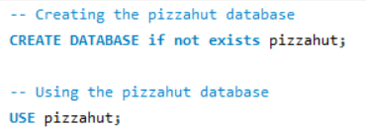

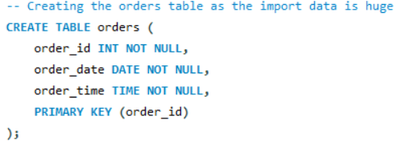
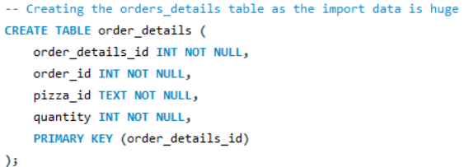

Slide 5
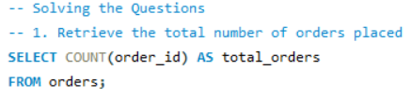




Slide 6
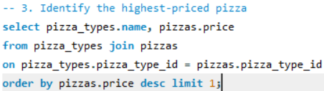

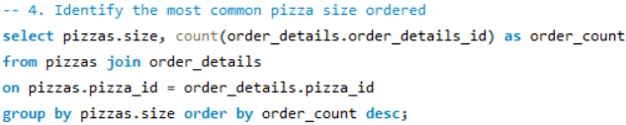
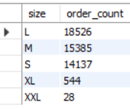

Slide 7
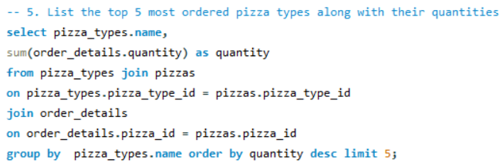
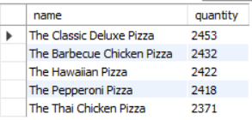

Slide 8
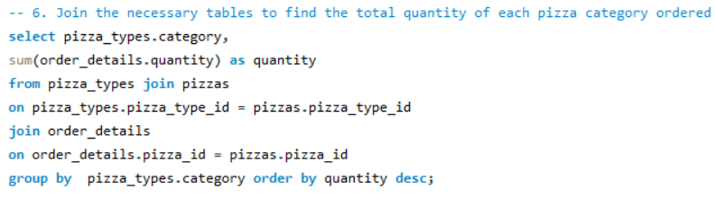
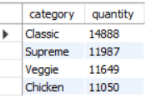

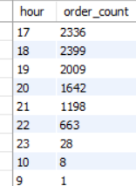

Slide 9

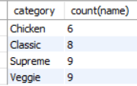
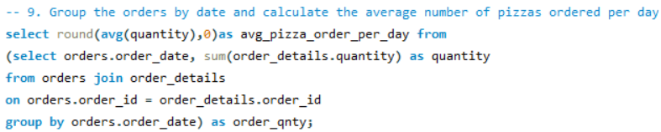


Slide 10
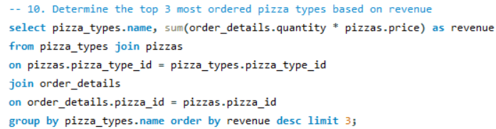

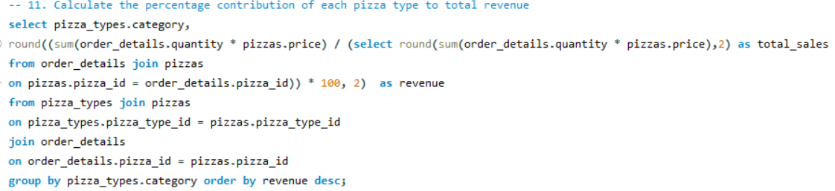
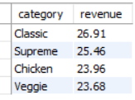

Slide 11
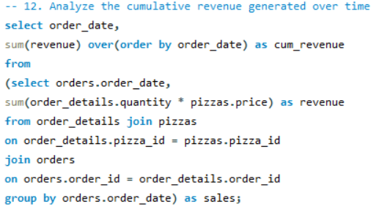
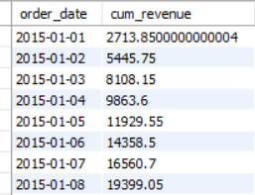

Slide 12
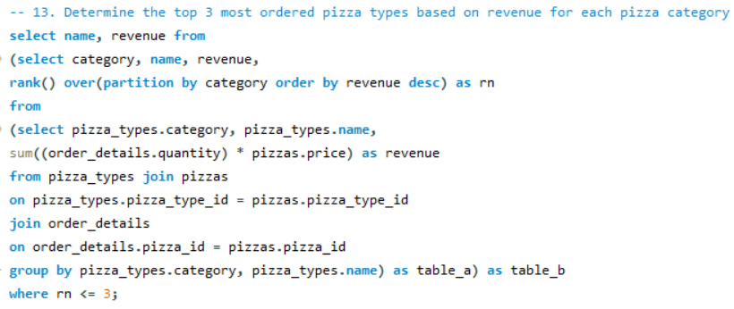
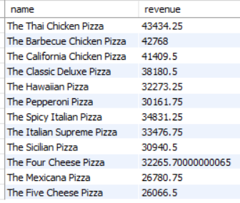

Slide 13
Thank you!

